Slide 1
Java Tools
Tools, Editors

Slide 2
Java Editors
Notepad
Wordpad
MS Word
Notepad ++
Editplus

Slide 3
Java IDEs
Eclipse
My Eclipse
Netbeans
JDeveloper
IntelliJ IDEA

Slide 4
Online Java Compilers
https://ideone.com/
http://www.tutorialspoint.com/compile_java_online.php
http://browxy.com/

Slide 5
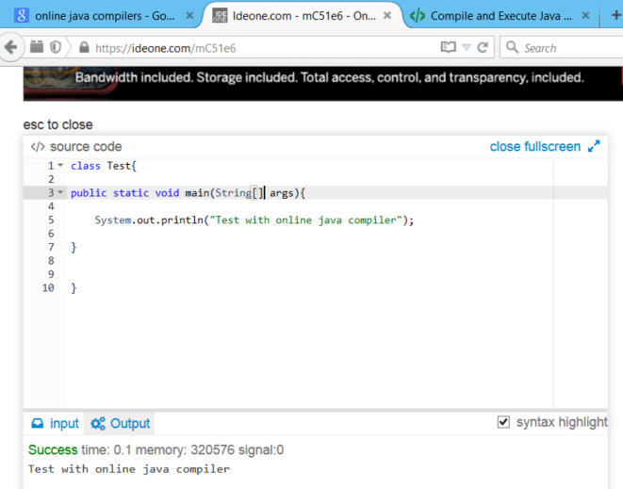
IDEOne Online compiler

Slide 6
Java Decompiler
We have online and offline de compilers

Slide 7
JD-GUI
JD-GUI is a standalone graphical utility that displays Java source codes of “.class” files. You can browse the reconstructed source code with the JD-GUI for instant access to methods and fields.
http://jd.benow.ca/ - link to download softwares

Slide 8
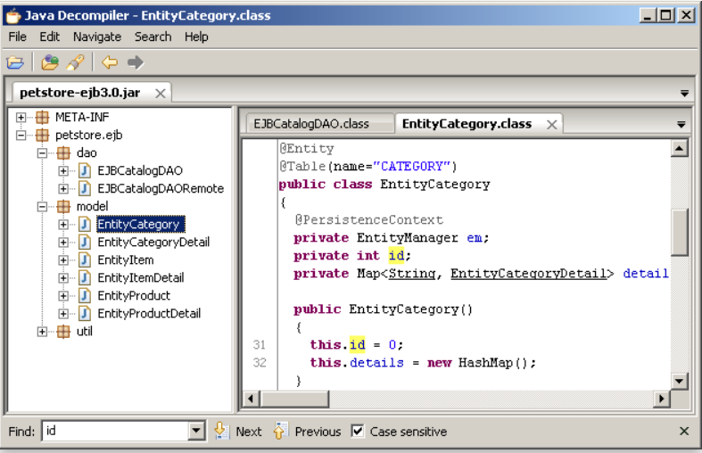
JD-GUI

Slide 9
JD-Eclipse
JD-Eclipse is a plug-in for the Eclipse platform. It allows you to display all the Java sources during your debugging process, even if you do not have them all.

Slide 10
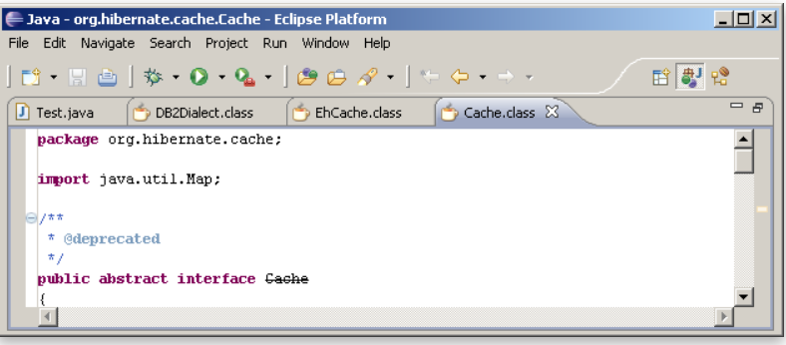
JD-Eclipse

Slide 11
Code Review tools
Findbugs

Slide 12
Three that were sufficiently powerful and that met the IDE support criterion:
PMD
Checkstyle
Jalopy.

Slide 13
PMD looks for these things
Unused local variables
Empty catch blocks
Unused parameters
Empty if statements
Duplicate import statements
Unused private methods
Classes that could be Singletons
Short/long variable and method names

Slide 14
Checkstyle looks for these things:
Javadoc comments
Naming conventions
Headers
Imports
Size violations
White space
Modifiers
Blocks
Miscellaneous checks (including some useful checks like unnecessary System.out and printstackTrace)

Slide 15
Jalopy
Jalopy is an easily configurable source code formatter that can detect, and fix, a number of code convention flaws that might appear in Java code. Jalopy is more of a code fixer than a code checker. Jalopy plug-ins are present for most IDEs and, in most cases, they gel quite seamlessly with the IDE. I found Jalopy to be a particularly powerful tool, capable of doing a lot of cool things. For instance, it can fix code indentation, brace alignment, and line wrapping beyond a certain character length, insert relevant Javadoc comments, and sort imports. The best part is that Jalopy is superbly configurable. A simple UI lets you tweak almost anything that Jalopy does; no tweaking with XML configuration files is required.

Slide 16
PMD – Eclipse plugin
To install the PMD plugin for Eclipse:
Start Eclipse and open a project
Select "Help"->"Software Updates"->"Find and Install"
Click "Next", then click "New remote site"
Enter "PMD" into the Name field and "http://pmd.sf.net/eclipse" into the URL field
Click through the rest of the dialog boxes to install the plugin
Alternatively, you can download the latest zip file and follow the above procedures except for using "New local site" and browsing to the downloaded zip file.
To configure PMD, select "Windows"->"Preferences", then select PMD.
To run PMD, right-click on a project node and select "PMD"->"Check code with PMD".
To run the duplicate code detector, right-click on a project node and select "PMD"->"Find suspect cut and paste". The report will be placed in a "reports" directory in a file called "cpd-report.txt".
To find additional help for other features, please read included help by selecting Help->Help Contents and browse the "How to..." section in the "PMD Plugin Documentation" book.
After installing an update, if you get an Exception such as "java.lang.RuntimeException: Couldn't find that class xxxxx", try deleting the ruleset.xml file in the .metadata/plugins/net.sourceforge.pmd.eclipse directory in your workspace.
To get Eclipse to not flag the @SuppressWarnings("PMD") annotation, look under the menu headings Java -> Compiler -> Errors/Warnings -> Annotations -> Unhandled Warning Token.

Slide 17
File transfer tools from local to windows machine
Winscp
filezilla

Slide 18
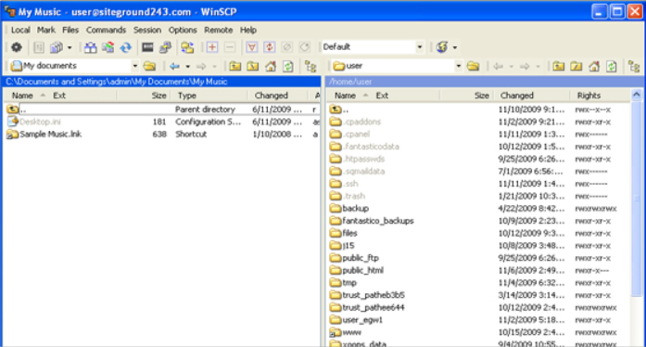
winscp
WinSCP (Windows Secure CoPy) is a free and open-source SFTP, FTP, WebDAV and SCP client for Microsoft Windows. Its main function is secure file transfer between a local and a remote computer.

Slide 19
Filezilla
FileZilla is a powerful and free software for transferring files over the Internet. FileZilla is a very popular FTP client and is used by webmasters from all over the world.

Slide 20
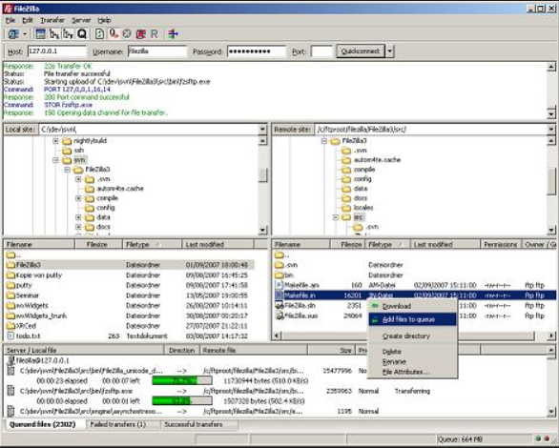
FileZilla

Slide 21
File/Folder Comparing tools
Beyond Comparator
Beyond Compare is focused. Beyond Compare allows you to quickly and easily compare your files and folders. By using simple, powerful commands you can focus on the differences you're interested in and ignore those you're not. You can then merge the changes, synchronize your files, and generate reports for your records.

Slide 22
